Slide 1
Machine Learning 2 Midterm Review
Team 14

Slide 2
Agenda
Linear (Chapter 6)
Subset selection: Best subset & Stepwise
Shrinkage (regularization) Methods: ridge & lasso & tuning parameters
Dimension Reduction: PCR & PLS
Non-linear (Chapter 7)
Polynomial Regression
Step function
Splines: regression spline, natural spline, smoothing spline
Local Regression
GAM
Kahoot!

Slide 3
Outline (brainstorming)
Models Chapter 6:
Subset selection: Best subset & Stepwise
Shrinkage (regularization) Methods: ridge & lasso & tuning parameters
Dimension Reduction: PCR & PLS
Models Chapter 7:
Polynomial Regression
Step function
Splines: regression spline, natural spline, smoothing spline
How to calculate degrees of freedom
Basis function.
Local Regression (loess())
GAM (gam())
Chapter 8: Tree Conceptual
Notes:
Backward selection. We start with all variables in the model, and backward selection remove the variable with the largest p-value—that is, the variable that is the least statistically significant. The new (p − 1)-variable model is fit, and the variable with the largest p-value is removed. This procedure continues until a stopping rule is reached. For instance, we may stop when all remaining variables have a p-value below some threshold.

Slide 4
Subset Selection
Best Subset
Fits least squares regression for all possible combos
Identifies best model --> Cross validate prediction error
Computational limitations: 2^p
Overfitting, high variance
Stepwise Selection
Forward begins with no predictors and adds one by one
Variable with greatest improvement added
Backwards begins with all predictors, removes one at a time
Advantages vs disadvantages
more restrictive, works with large p
doesn’t guarantee best model, backwards requires n>p

Slide 5
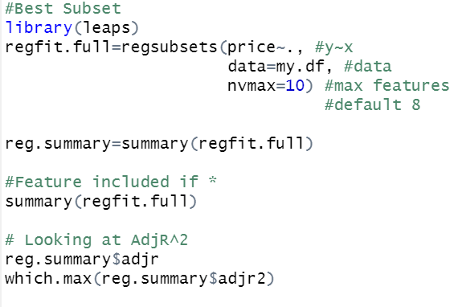

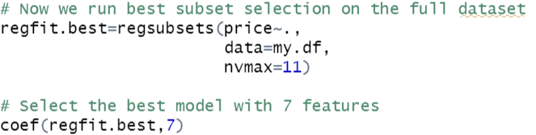
Subset Selection Code
Best Subset
Stepwise
Run validation/cross validation (train and test) to find best model # of features

Slide 6
Regularization: Ridge & Lasso Lab

Slide 7
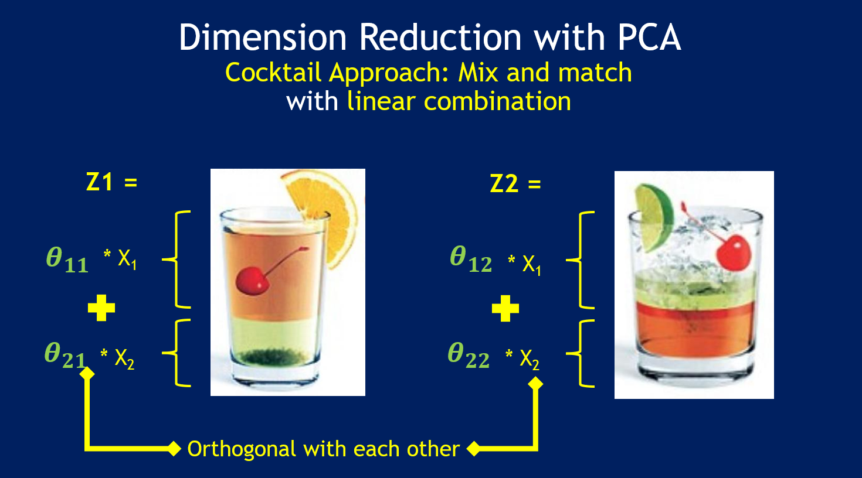
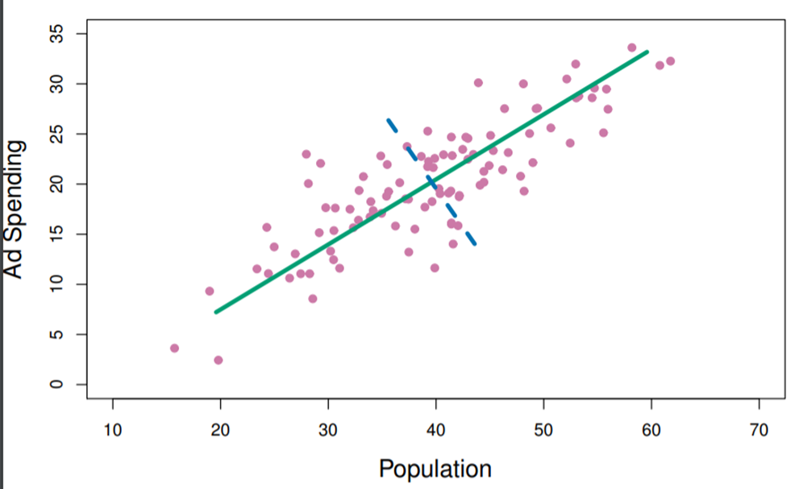
Dimension Reduction – PCR and PLS
Transform X features through linear combinations
You get M transformed features where M < P (dimension reduction!!)
Fit an LS model using M transformed features
This shows PCR instead of PLS!!!
green = 1st component
purple = 2nd component
lm(): Ŷ_{i} = β₀ + β₁ X₁ + β₁ X₂ + ……. β_{p} X_{p} pcr(): Ŷ_{i} = θ₀ + θ₁ Z₁ + θ₂ Z₂ + ……. θ_{M} Z_{M}

Slide 8
Difference Between PCR and PLS
PCR/PCA uses unsupervised identification of components in the X feature space
no use of Y outcome/response values
PLS uses supervised identification of components in the X feature space
Place highest weight on features most strongly related to Y

Slide 9

R Code – PCR and PLS
PCR
PLS

Slide 10
Polynomials: Lab

Slide 11
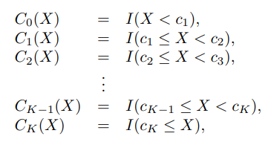
Step Functions
Non-linear, avoids imposing global structure
n>>p
Converts a continuous variable into an ordered categorical variable (bins)
Creating cut-points with I()
Automatic but can specify
Returns 1 if true, 0 if false
Effect of fitting piecewise constant function
Step reg:lm(Y ~ cut(X, k)) or
logistic reg: glm(Y ~ cut(X,k))

Slide 12
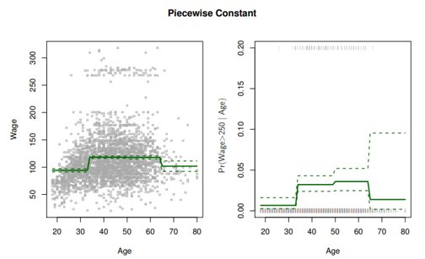
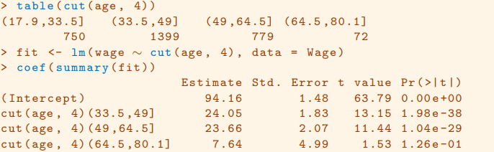

Step Function Code

Slide 13
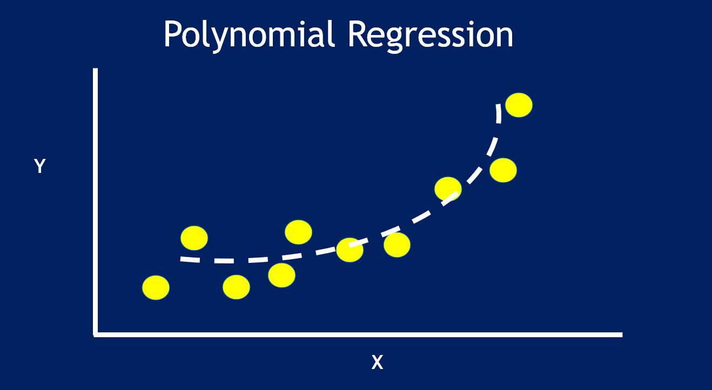
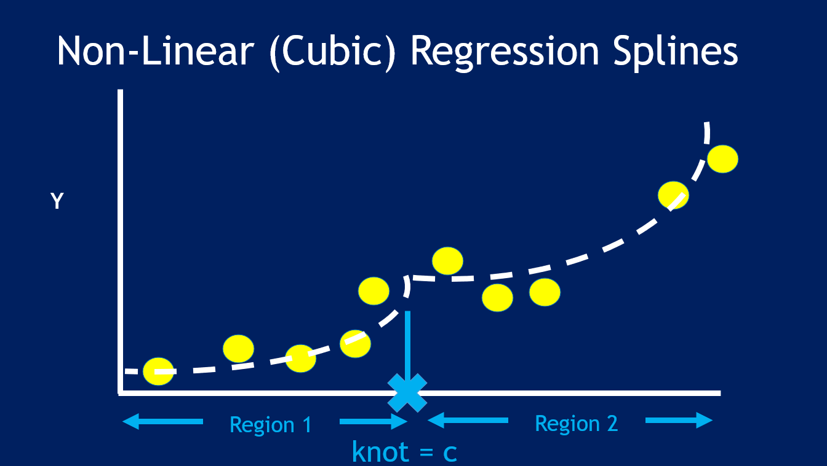

Regression Splines (piecewise polynomial)

Slide 14
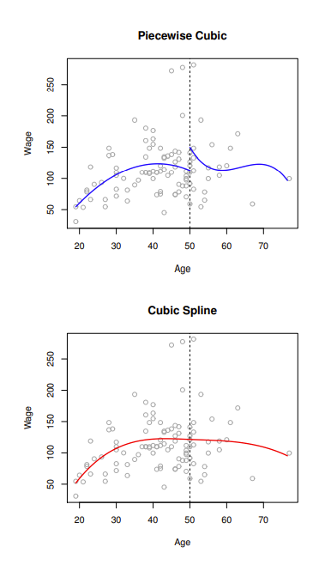
Regression Splines (cont.)
The degrees of freedom
quantity that summarizes the flexibility of a curve
Smaller the Df, more restrictive
For B-splines, df = 1 + d + k
1 = intercept
d = degree of poly
k = # of knots

Slide 15
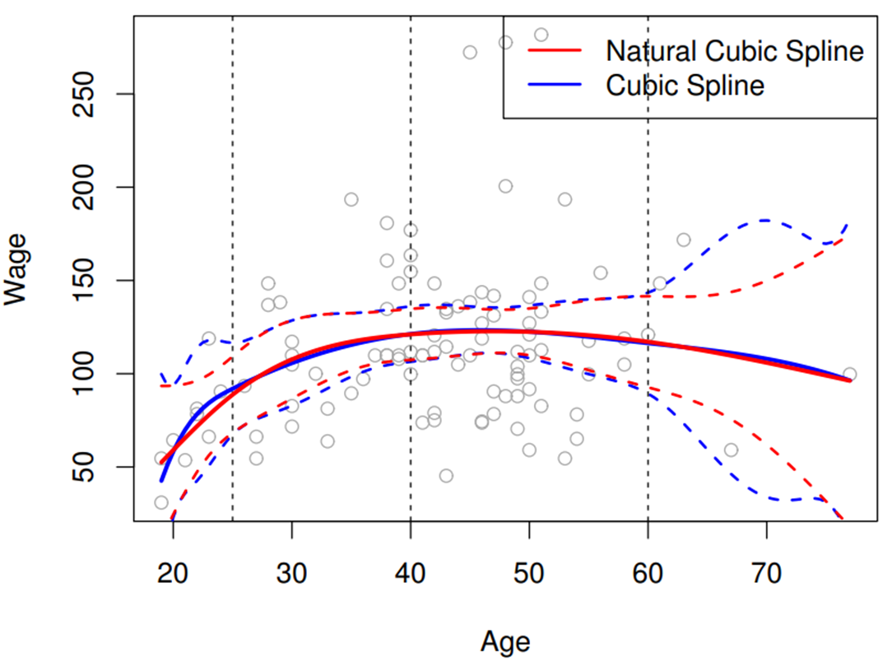
Natural Splines
Splines can have high variance in extreme ranges of X
Natural splines
additional boundary constraints
linear functions at the extremes
Total DF = 1 + d + k - 2

Slide 16
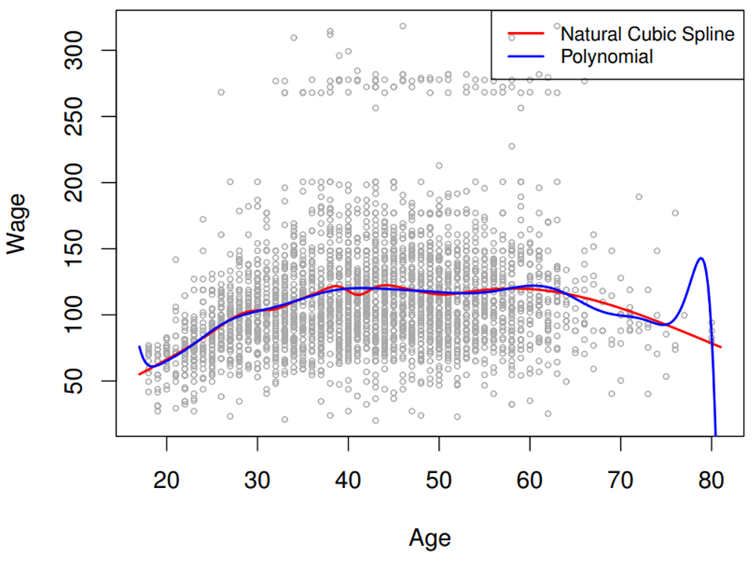
Polynomial vs Cubic Spline
Polynomials achieve flexibility by increasing degree d
Splines achieve flexibility by increasing k while keeping the degree d fixed

Slide 17
R Code – Regression and Natural Splines
#Regression Splines
lm(Y ~ bs(X, knots=c(1,2,3))
lm(Y ~ bs(X, df=6)
#Natural Splines
lm(Y ~ ns(X, knots=c(1,2,3))
lm(Y ~ ns(X, df=6)

Slide 18

Smoothing Splines
Prevent overfit by asking for a smooth model
smoothness = minimize second derivative (i.e. change in slope)
Wiggly function (roughness) = large second derivative
When λ = 0, then the penalty term in has no effect
function g will be very jumpy
When λ → ∞, g will be perfectly smooth
Uses Cross Validation to choose lambda
Loss Function + Penalty

Slide 19
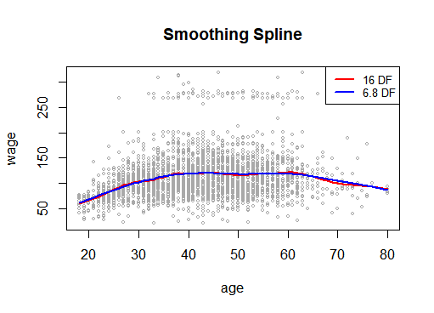
R Code – Smoothing Splines
smooth.spline(X, Y, df=16. lambda=5)
predict(s.model, x) # replace x w/ newdata
#predict() does not allow newdata=
smooth.spline(X, Y, df=16, cv=TRUE)
smooth.spline(age,wage,cv=TRUE)
df=6.8

Slide 20
Local Regression Lab

Slide 21
Generalized Additive Models
Allows non-linear function of variables while maintaining additivity
Applied to both quantitative (regression) and qualitative (classification)
Advantages:
Automatically model nonlinear relationships
More accurate predictions
Interpretability and Flexibility
Limitations
Restricted to additive models
Important interactions can be missed (manually add)

Slide 22
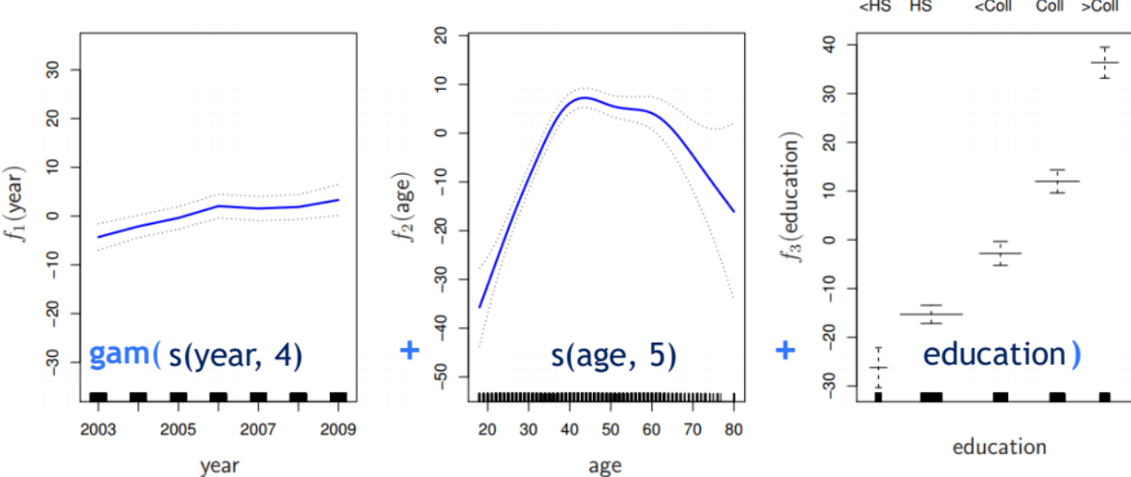

Slide 23

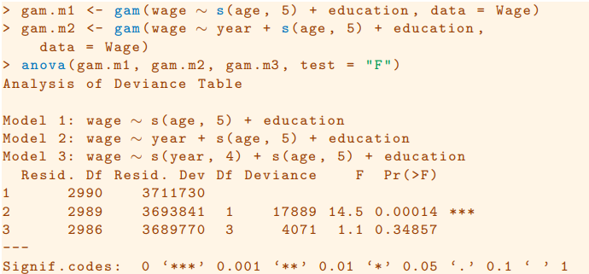
GAM Code
Lm/glm vs gam (with smoothing spline)

Slide 24
Kahoot Link
https://create.kahoot.it/details/1b79b754-e228-4681-92aa-2d27bf9d16e0

